Slide 1
Software Engineering (EIT-252)
Syllabus
Unit-I: Introduction
Introduction to Software Engineering, Software Components, Software Characteristics, Software Crisis, Software Engineering Processes, Similarity and Differences from Conventional Engineering Processes, Software Development Life Cycle (SDLC) Models: Water Fall Model, Prototype Model, Spiral Model, Evolutionary Development Models, Iterative Enhancement Models, Selection of Software Development Models.
Unit-II: Software Requirement Specifications (SRS)
Requirement Engineering Process: Elicitation, Analysis, Documentation, Review and Management of User Needs, Feasibility Study, Information Modeling, Data Flow Diagrams, Entity Relationship Diagrams, Decision Tables, SRS Document, IEEE Standards for SRS, Estimation of various Parameters such as Cost, Efforts, Schedule/Duration, Constructive Cost Models (COCOMO), Resource Allocation Models, Software Risk Analysis and Management.

Slide 2
Unit-III: Software Design
Basic Concept of Software Design, Architectural Design, Low Level Design: Modularization, Design Structure Charts, Pseudo Codes, Flow Charts, Coupling and Cohesion Measures, Design Strategies: Function Oriented Design, Object Oriented Design, Top-Down and Bottom-Up Design. Software Measurement and Metrics: Various Size Oriented Measures: Halestead’s Software Science, Function Point (FP) Based Measures, Cyclomatic Complexity Measures: Control Flow Graphs.
Unit-IV: Software Testing
Software Testing Objectives, Unit Testing, Integration Testing, Acceptance Testing, Regression Testing, Testing for Functionality and Testing for Performance, Top-Down and Bottom-Up Testing Strategies: Test Drivers and Test Stubs, Structural Testing (White Box Testing), Functional Testing (Black Box Testing), Test Data Suit Preparation, Alpha and Beta Testing of Products. Static Testing Strategies: Formal Technical Reviews (Peer Reviews), Walk Through, Code Inspection, Compliance with Design and Coding Standards.

Slide 3
Unit-V: Software Maintenance and Software Project Management
Software as an Evolutionary Entity, Need for Maintenance, Categories of Maintenance: Preventive, Corrective, Adaptive and Perfective Maintenance, Cost of Maintenance, Software Re-Engineering, Reverse Engineering, Software Configuration Management Activities, Change Control Process, Software Version Control, Defect Detection and Removal: Defect Amplification Model, An Overview of CASE Tools.
Text and Reference Books:
R. S. Pressman, Software Engineering: A Practitioners Approach, McGraw Hill Publication.
K. K. Aggarwal and Yogesh Singh, Software Engineering, New Age International Publishers.
Rajib Mall, Fundamentals of Software Engineering, PHI Publication.
Carlo Ghezzi, M. Jarayeri, D. Manodrioli, Fundamentals of Software Engineering, PHI Publication.
Ian Sommerville, Software Engineering, Addison Wesley.
Pankaj Jalote, Software Engineering, Narosa Publication
Pfleeger, Software Engineering, Macmillan Publication.
A. Leon and M. Leon, Fundamentals of Software Engineering, Vikas Publication.

Slide 4
Lab Work
Lab exercises or a Mini Project (as per list given below) to be carried out using languages like C++, Java, C# and tools like Visio, ARGOUML, Rational Rose etc. Design and Implementation of an Object based application using any one of the above languages/tools is desirable.
Hotel Automation System
Book Shop Automation Software
Word processing Software

Slide 5
Lab Work
Software Component Cataloguing Software
Payroll System
Banking System
Purchase Order System
Library Management System
Railway Reservation System
Bill Tracking System
University Admission System
Estate Management System.

Slide 6
Course Outcomes (COs)
Understand and explain various concepts of software engineering and software life cycle development models. (Understand)
Prepare SRS and Compute cost and effort required to complete a given project, using various estimation techniques and models. (Apply)
Understand various concepts of Software design and Construct Data Flow Diagrams, Data Dictionaries and UML diagrams for a given software requirement specification. (Understand, Apply)

Slide 7
Course Outcomes (COs)
Understand various testing techniques and use these concepts to design optimal test cases. (Understand, Apply, Analyze)
Understand software configuration management, version control, reverse engineering, defect tracking etc. (Understand)
Build a project report as a team which contains the requirement specification, plan, schedule and design documents based on the knowledge of software development lifecycle. (Apply)

Slide 8
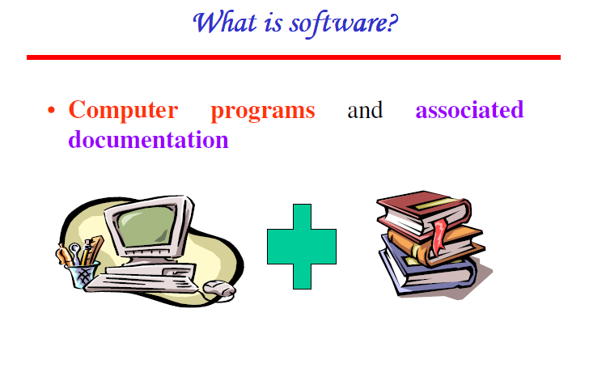

Slide 9
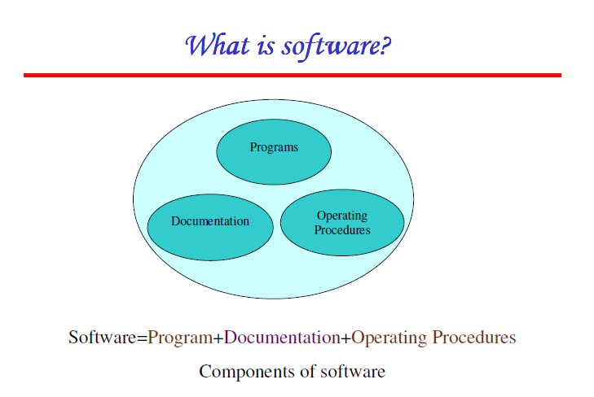

Slide 10
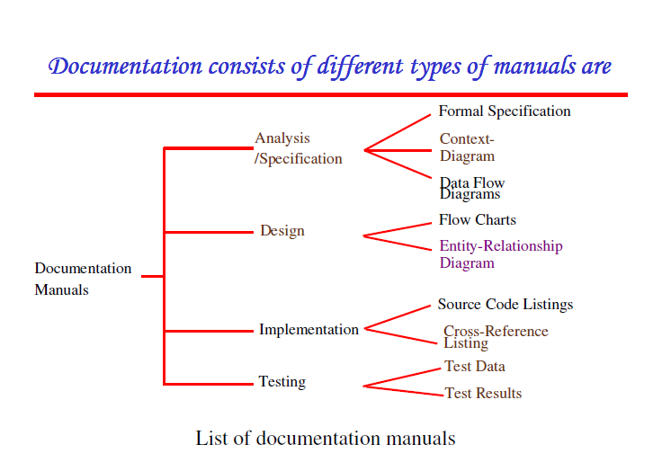

Slide 11
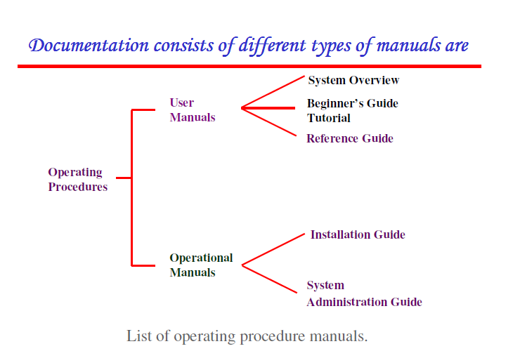

Slide 12
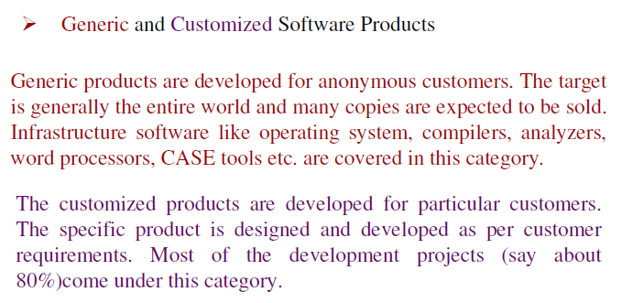
Software Products

Slide 13
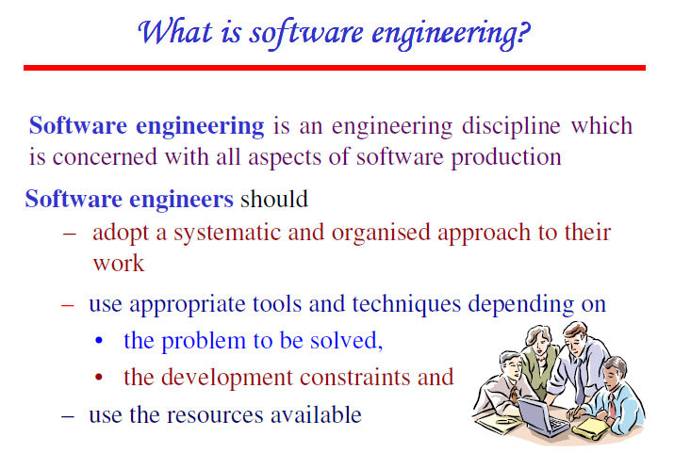

Slide 14
Software Engineering
A strategy for producing high quality software, which satisfies customer requirements and is within budget and schedule.
Software engineering encompasses a process, management techniques, technical methods, and the use of tools.

Slide 15
Software Engineering
Deals with the management techniques required to
Plan
Organize
Control
Monitor

Slide 16
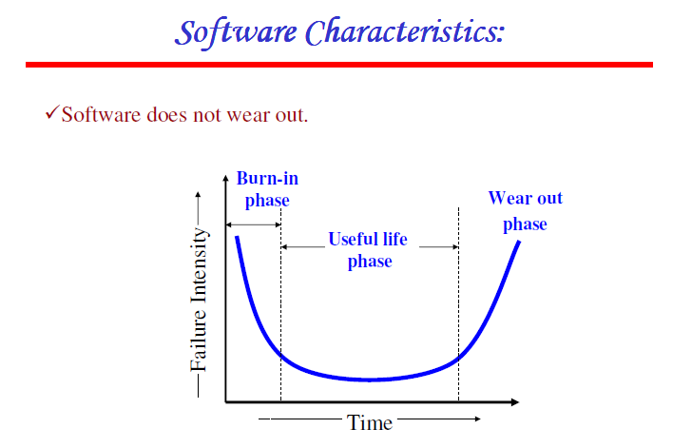

Slide 17
Software does not Wear Out
Software does not wear out rather it becomes more reliable with time until it finally retires.
But, ultimately it becomes obsolete due to change in environment for which it was developed.
Software may finally retire due to environment changes, new requirements, and new expectations etc.

Slide 18
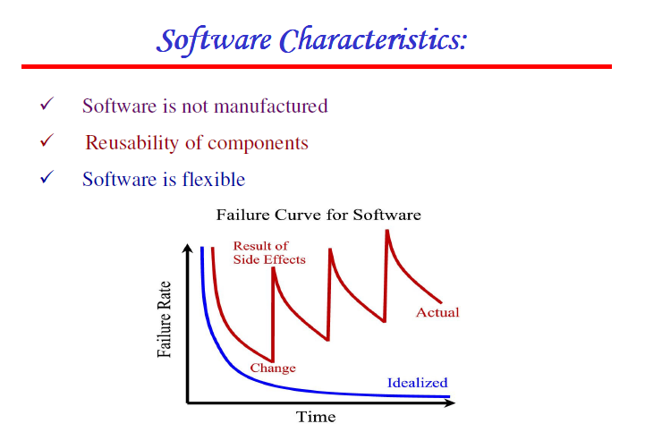

Slide 19
Software is not Manufactured
Life of a software is from the concept exploration to the retirement.
It involves one time development and continuous maintenance efforts to keep it operational.
Making multiple copies of software does not involve any additional cost.
In H/W products every product costs us due to raw material and other processing expenses.
Catalogue of hardware components used during manufacturing of hardware systems.
There is no assembly line in software development. Hence it is not manufactured.

Slide 20
Reusability of Components
For manufacturing H/W systems we may not require to manufacture any components rather they need to be collected off the self and properly assembled.
We may have standard quality guidelines and effective processes to produce a good quality product.
But, in software every product is new and requires start from the scratch. No reusability.
However, concept of reusability is now introduced through component oriented design concept.
In h/w reusability of components is a natural part of engineering process but in s/w it is just a humble beginning.

Slide 21
Software is Flexible
Everyone considers software as flexible and assumes that it can be developed for everything.
Software being flexible, every change can be accommodated at any stage of development of software.
This myth of implementing almost “everything” has made the software development difficult to plan, monitor and control and leads to “software crisis”.

Slide 22
Software Crisis
Project running over budget.
Project running over time.
Poor quality of the developed software.
Insufficient software productivity.
Software does not meet requirements.
Software failed or could not be delivered to the customer.
Software is unmanageable and code is difficult to maintain.

Slide 23
Software Crisis
(Need of Software Engineering)
A survey conducted by IBM in 2000 reports that
  31% of the projects get cancelled before completion.
  53% of the projects exceed to the budget schedule even up to 189%.
  94% of the projects have many restarts.
Software failures receive a lot more publicity than software engineering success stories.

Slide 24
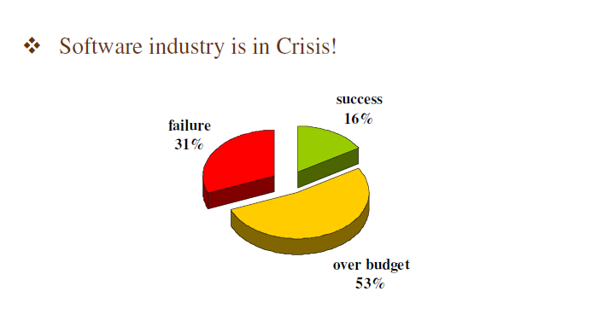

Slide 25
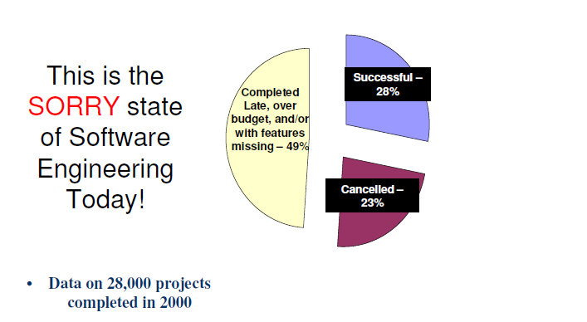

Slide 26
Software Crisis
Software cost has not dropped as rapidly as the hardware cost.
Developers in H/W industry have significantly affected cost, quality, productivity and reliability of hardware.
In S/w industry, there is no single development either in technology or in mgmt. technique that by itself promises even one order of magnitude improvement in the productivity, cost and reliability.
Use of CASE tools was thought to be a development giving boost to above factors but the results are highly un satisfactory.

Slide 27
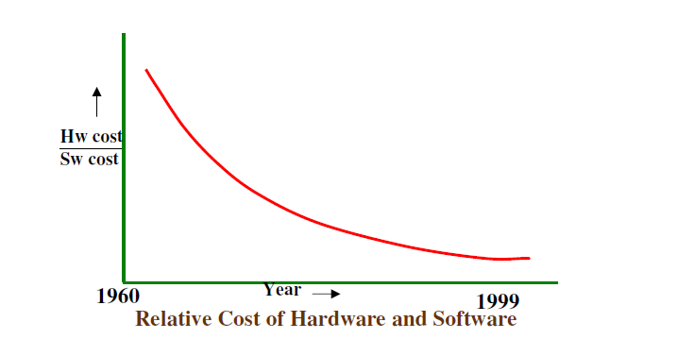

Slide 28
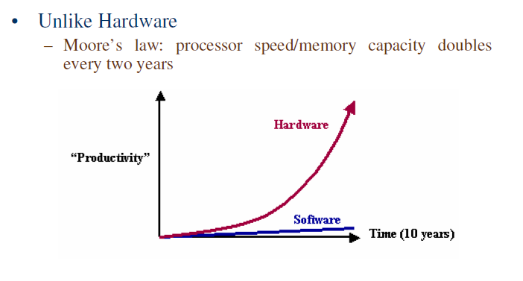

Slide 29
Software Process
Software process is basically the way in which software is developed.
To survive in the competitive s/w business requires more than hiring smart & knowledgeable developers and latest tools.
Additionally, effective development process is also required to substantially improve the quality, productivity and maintenance efforts.
It is very difficult to improve the software process due to certain reasons.

Slide 30
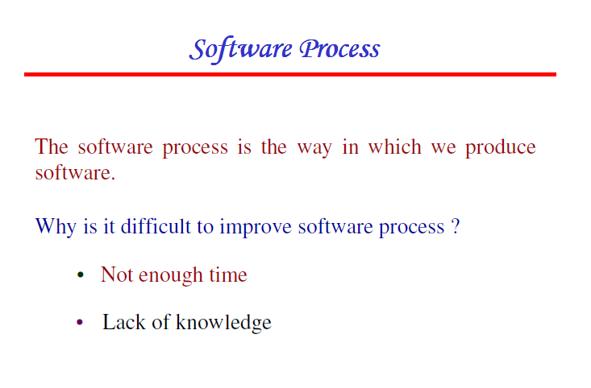

Slide 31
Not Enough Time
Unrealistic schedules leave insufficient time to do the essential project management work.
No software groups are sitting around with plenty of time to explore what is wrong with the current development process.
Customers and managers demand for high productivity and quality in minimum time.
There is almost always shortage of time and pressure on the developers. As a consequence the first release may be in time but they may have to ship the next release immediately after fixing the bugs recently discovered.

Slide 32
Lack of Knowledge
Software developers are not familiar with the industry best practices.
Software developers do not devote time in studying literature on best known ways of software development.
They just learn Java, VB, or ORACLE but don’t look for anything on process, testing, or quality.
Process improvement frameworks like CMM, ISO 9001 are not in realistic use.

Slide 33
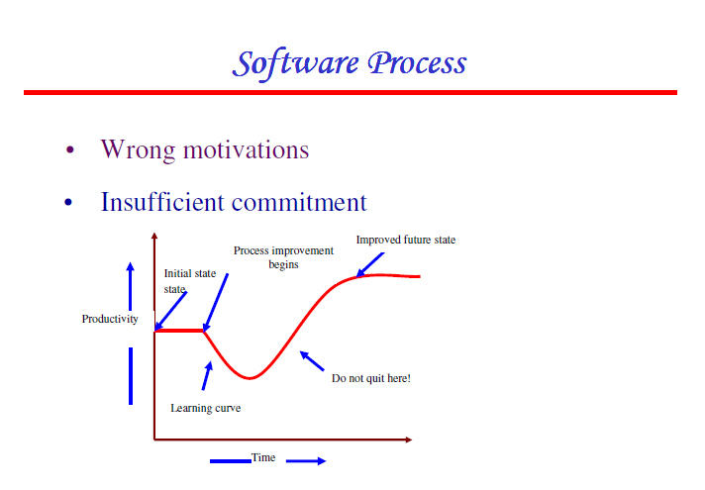

Slide 34
Wrong Motivation
Process improvement initiatives are launched with wrong reasons like contractor demand, or directions of the senior manger.
Basic motivation should be to remove present difficulties with the process.
Most of the people should be motivated by the prospect of meeting their commitments, improving customer satisfaction, and delivering excellent product.
Reasons for implementation of an improvement framework should be clearly explained to the developers.

Slide 35
Insufficient Commitment
Many times the process improvement initiatives fail due to insufficient commitment.
It starts with the process assessment but fails to follow through with the actual changes.
Management sets no expectations, devote insufficient resources, write no improvement plans, develop no roadmap and pilot no new processes.
Process improvements will not be visible immediately rather may have a drop in productivity due to efforts for the current demand being siphoned of for the better future.
At this stage, companies should not give up, but should take motivation from the success stories of good companies.

Slide 36
Software Myths
Generally divided in three groups: Management myths, Customers myths and Practitioners myths.
Getting behind the schedule can be make up by introducing more persons: Sometimes, it may further delay because of time required for training the new comers, cross talks etc. - M
A general statement of objective is sufficient for software development, the details can be easily incorporated later: Incorporation of details is difficult and costly. - C
Software being flexible can be easily modified: Cost of change is very high. -M

Slide 37
Software Myths
Quality can be assessed only after getting the running program: Quality assurance is an umbrella activity which begins since inception and covers all phases of development. FTR’s during all phases are conducted to improve quality. - P
Once the software has been written and get to work our job is over: Sooner you begin to write the code the longer it will take you to get done. - P
Working program is the only deliverable: Documentation including user and operation manuals are also to be delivered. - P
Software Engineering makes the things complex and may slow down the process: Principles and practices of SE improve the process and quality of the software. - P

Slide 38
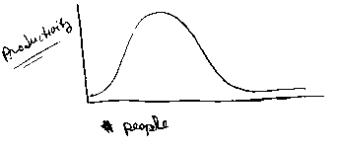
Productivity and People

Slide 39
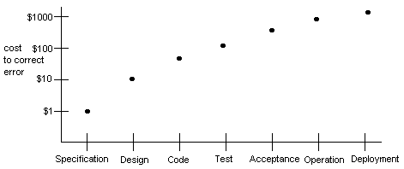
Early Error Detection
Saves Money

Slide 40
Software Applications
System Software: Software used to improve efficiency of other s/w or h/w. e.g. Compilers, Editors, Device Drivers, OS.
Real Time Software: Used to monitor, control and analyze the real world events as they occur.
Embedded Software: Placed in a ROM controls various functions of a system.
Business Software: Used to process business applications. e.g. Payroll, Employee Management System, Library Management System, Security System.
AI Software: Used to solve non algorithmic problems. e.g. Expert System, Game playing.
Engineering and Scientific Software: Huge computing required for data processing. CAD/CAM Packages, SPSS, MATLAB
Web Based Software: Web application s/w like HTML, CGI, Java, Perl, DHTML

Slide 41
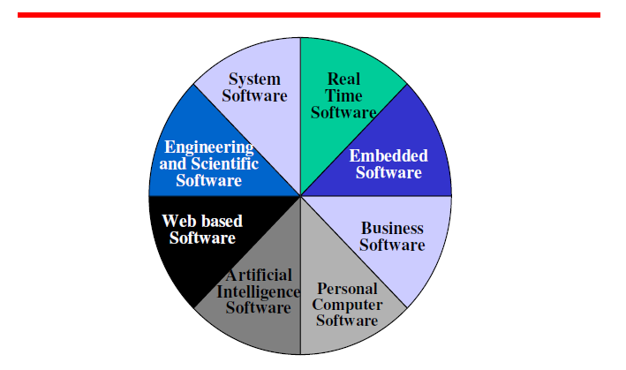
Software Applications

Slide 42
Software Engineering Phases
Definition Phase
  Focuses on What (information engineering, software project planning, requirements analysis).
Development Phase
  Focuses on How (software design, code generation, software testing).
Support Phase
  Focuses on Changes (corrective maintenance, adaptive maintenance, perfective maintenance, preventive maintenance).

Slide 43
Software Life Cycle Phases
Requirements, analysis, and design phase.
System design phase.
Program design phase.
Program implementation phase.
Unit testing phase.
Integration testing phase.
System testing phase.
System delivery.
Maintenance.

Slide 44
S.E. Management Spectrum
4 P’s
People
Product
Process
Project

Slide 45
Project Effort Distribution
Generally accepted guidelines are:
  02-03 % planning
  10-25 % requirements analysis
  20-25 % design
  15-20 % coding
  30-40 % testing and debugging
40-20-40 Rule

Slide 46
5W2H Principle
Why is the system being developed (Scope) ?
What will be done (SRS) ?
When it will be done (Schedule) ?
Who is responsible for a function (Resource)?
Where are they organizationally located (Organization) ?
How will the job be done technically and managerially (Process) ?
How much of each resource is needed (Estimation) ?

Slide 47
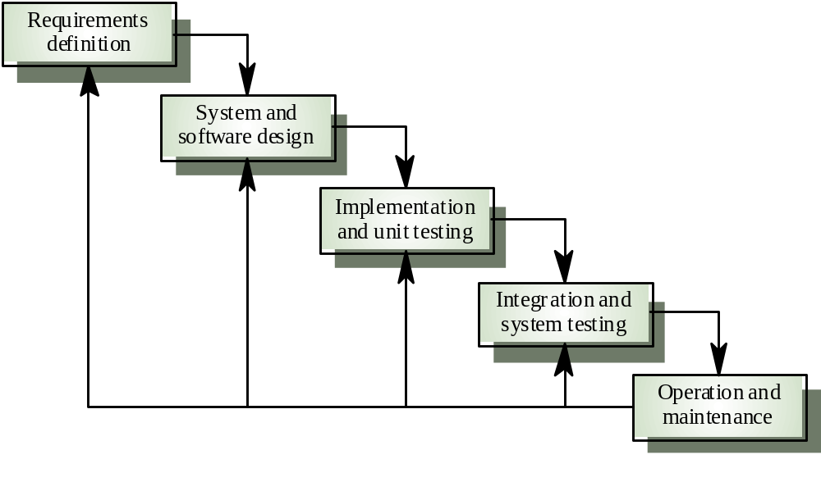
Linear Sequential Model or Waterfall Model

Slide 48
Waterfall Model
The software development activity is divided into different phases.
Each phase consists of a series of tasks and has different objectives.
Output of one phase becomes the input of the next phase.
It is mandatory for a phase to be completed before the next phase starts. Thus, there is no overlapping of the phase activities/tasks.
Waterfall model is the pioneer of the SDLC processes.
It was the first model which was widely used in the software industry.

Slide 49
Advantages and Disadvantages
Easy to understand and reinforces the notion of “define before design” and “design before code”.
Suitable for smaller projects. Does not scale up well for very large projects due to high risk.
Since the phases are rigid and precise, one phase is done one at a time, it is easy to maintain.
The entry and exit criteria are well defined, so it is easy and systematic to proceed with quality.
Requires defining all the requirements in the beginning which is very difficult. Not suitable for accommodating any changes at later stages.
Working version of the system is available very late.
Suitable for situations where the requirements and their implementations are fixed and well understood.

Slide 50
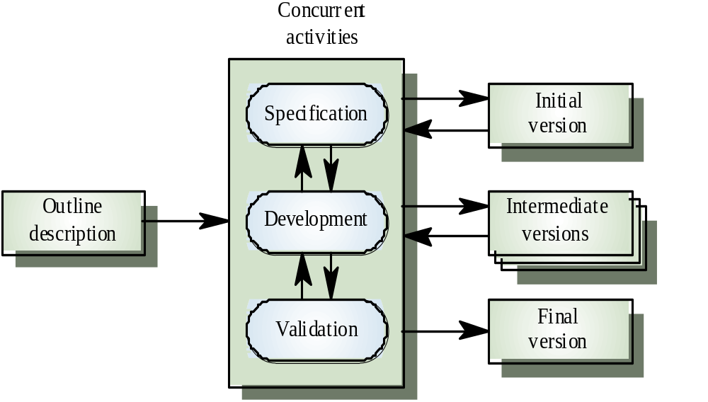
Prototype Model

Slide 51
Prototyping Model
Requirements
Users get a feel of the actual system and developers get to build something immediately
Focuses only on visible aspects and not on quality /efficiency parameters
Quick design
Refinement of Requirements as per suggestions
Implementation
Ideally prototype serves as a mechanism for identifying requirements precisely
Customer Evaluation
Now engineer the product using usual phases of software development

Slide 52
PM Features
Working prototype is developed as per the current available requirements. Prototype is a toy implementation of the system.
It has limited functionality, low reliability, and poor performance (stripped down version of the final product).
Refined versions of prototype are more and more suitable.
Final prototype approved by the customer can be used to draw requirements for the ultimate product development through WFM.

Slide 53
Advantages and Disadvantages
Reduce the risk of incorrect user requirements and suitable where requirements are changing.
Regular visible process aids management .
Support early product marketing and Reduce Maintenance cost.
An unstable/badly implemented prototype often becomes the final product.
Require extensive customer collaboration which may not be always available.
Special tools & techniques are required to build a prototype which are expensive. But still the overall cost is relatively low because of the experience gained.
It is a time-consuming process.

Slide 54
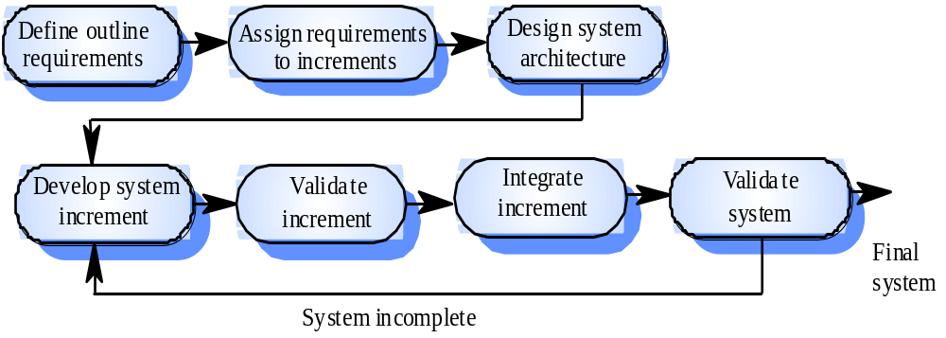
Incremental/Iterative Enhancement Model (IEM)

Slide 55
Incremental/Iterative Enhancement Model (IEM)
Rather than delivering the system as a single unit, the development and delivery is broken down into increments.
Each increment/version incorporates part of the required functionality.
User requirements are prioritised and the highest priority requirements are included in early increments.
Once the development of an increment is started, its requirements are “frozen” while requirements for later increments can continue to evolve.

Slide 56
IEM Advantages/Disadvantages
Useful functionality is delivered with each increment, so customers derive value early.
Early increments act as a prototype to help elicit requirements for later increments.
There is Lower risk of overall project failure.
The highest priority system services tend to receive the most testing.
Not suitable for the situation where requirements may NOT be partitionable into stand-alone increments.

Slide 57
Evolutionary Development Model
Evolutionary process model resembles the iterative enhancement model.
The same phases as defined in the waterfall model occur here in a cyclical fashion.
This model differs from the IEM in the sense that this does not require a working/useful product at the end of each cycle.
In EDM, requirements are implemented by category rather than by priority.
For example, in a simple DB application, one cycle might implement the GUI, another file manipulation, another queries and yet another updates.

Slide 58
Advantages/Disadvantages
Use of EDM brings a significant reduction in risk for software projects.
EDM can reduce costs by providing a structured, disciplined avenue for experimentation.
EDM allows the marketing department access to early deliveries, facilitating the development of documentation and demonstration.
Better fit the product to user needs and market requirements.
Manage project risk with the definition of early cycle content.
Uncover key issues early and focus attention appropriately.
Increase management visibility of project progress.

Slide 59
Rapid Action Development Model
This is an incremental process model developed by IBM in 1980.
In this model, user involvement is essential from requirement phase to delivery of the product which ensures users expectations and perspective in requirements elicitation, analysis and design of the product.
The process starts with developing a rapid prototype and giving it to the user for evaluation.
The prototype is then refined on the basis of user feedback and the process continues till the requirements are finalized.

Slide 60
Rapid Action Development Model
It involves four phases namely Requirements Planning, User Description, Construction, and Cut Over with participation of the user throughout.
Requirements are captured using any group elicitation technique (FAST,QFD, Brainstorming).
Joint Teams of developers and users prepare, understand and review the requirements.
Construction phase combines the detailed design, coding and testing phases of WFM.
Sophisticated automation tools like code generators, screen generators etc. are used in the construction.
In cut over phase, acceptance testing by the users, installation of the system, and user training is done.

Slide 61
Advantages/Disadvantages
Due to fast delivery of the rapid prototype, quick initial views of the product are possible.
The development time is reduced due to the use of powerful development tools.
Continuous involvement of the customer increases the product acceptability.
Model is not suitable in situations where user involvement is limited.
Development time can not be reduced in an environment where reusable components are not available.
Highly specialised and skilled developers are needed and such developers may not be available very easily.
It may not be effective if system can not be properly modularised.

Slide 62
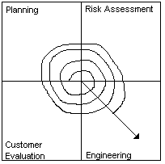
Spiral Model
Determination of objectives, alternatives and constraints
Analyze alternatives and attempt to identify & resolve the risks
Evaluation by the customer and feedback reporting
Actual product development and testing

Slide 63
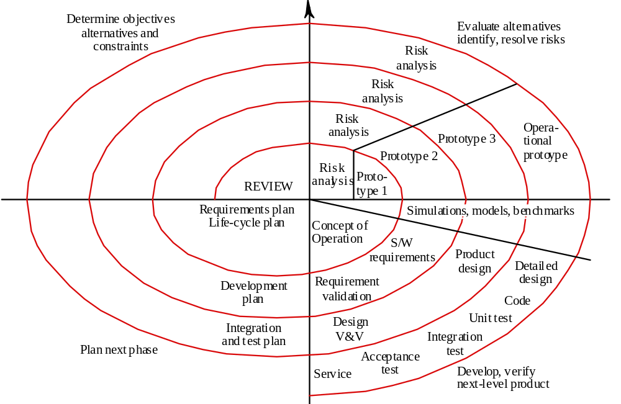
Spiral Model

Slide 64
SM Features
Spiral Model was proposed by Barry Boehm in 1986 by incorporating Project Risk factor in life cycle model.
Entire development space is supposed to be divided into 4-6 regions.
Radial dimension represents the cumulative cost of development. Each path around the spiral is indicative of the increased cost.
Angular dimension represents the progress made in completing each cycle.
Each loop from x-axis clockwise through 360 degree represents one phase.

Slide 65
SM Features
One phase is usually split into four sectors of major activities like Planning, Risk Analysis, Development, and Assessment (Customer Evaluation)
During first phase planning is done, risks are analyzed, prototypes are built, and customer evaluates the prototype. In subsequent phases more refined prototypes are built.
Good feature is that each phase is completed with a review /evaluation by the concerned people.
It includes quality objectives in the development by eliminating error in the early phases through evaluation process.

Slide 66
Advantages/Disadvantages
This model accommodates good features of other life cycle models. It becomes equivalent to another life cycle model in appropriate situations.
The risk analysis and validation steps eliminate errors in the early phases of development and thus incorporate s/w quality objectives in development process.
Difficulties with the model include lack of explicit process guidance in determining objectives, constraints, alternatives, relying on risk assessment expertise and providing more flexibility.

Slide 67
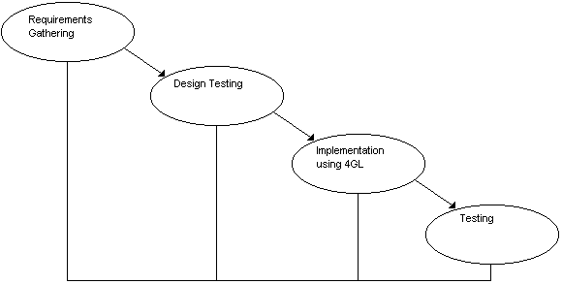
Fourth Generation Language Techniques
Specify some characteristic
of the s/w at high level, tool automatically generates source codes based on specifications.

Slide 68
4 GT Include
Non Procedural Languages
Query Languages
Report Generators
Graphic Utilities
Spread Sheets
Code Generators
Data Processors

Slide 69
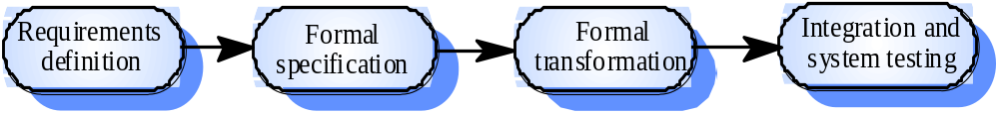
4 GT Model
Code Generator ?
Not realistic, unless “Formal specification” is source code…

Slide 70
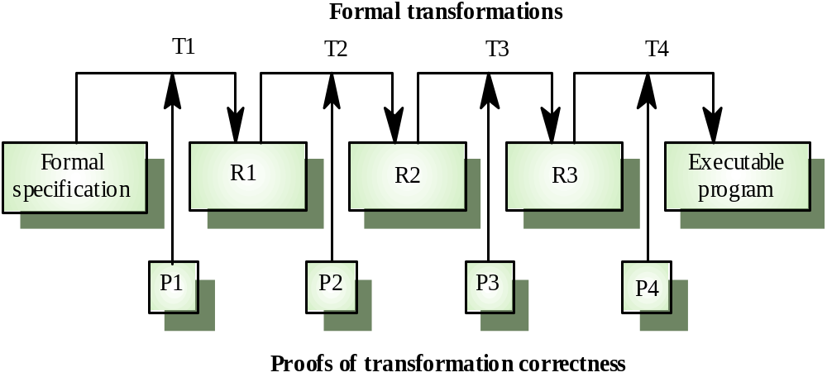
Formal transformations

Slide 71
Advantages/Disadvantages
Small software may be directly implemented from the requirement specifications.
Reduction in the development time.
Increase in productivity.
4 GT is not easy to use.
Codes generated are generally inefficient.
Normally used for business information system applications and for designing large projects.

Slide 72
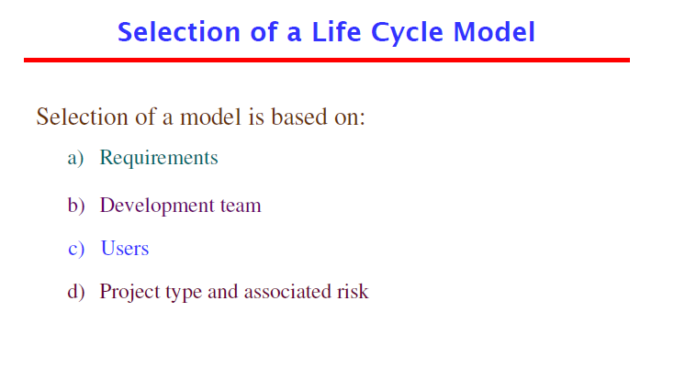

Slide 73
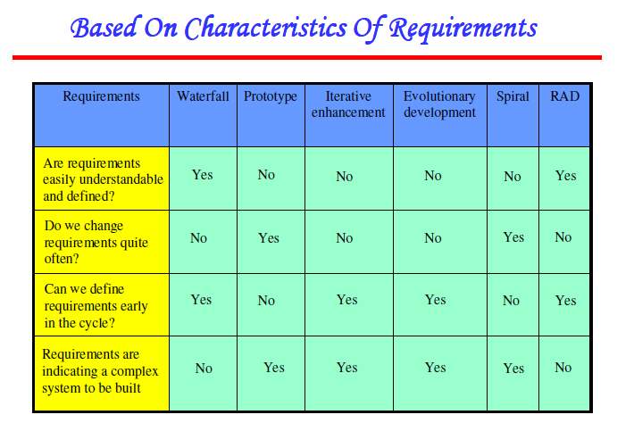

Slide 74
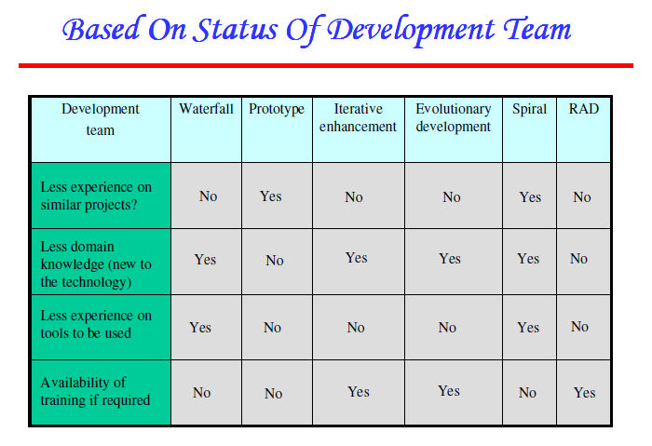

Slide 75
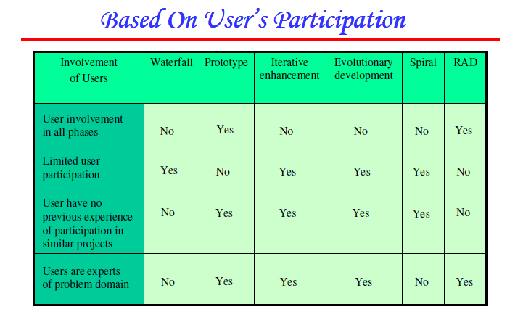

Slide 76
